Slide 1
Implementing Subprograms
BBM 301 – Programming Languages

Slide 2
The General Semantics of Calls and Returns
The subprogram call and return operations of a language are together called its subprogram linkage
General semantics of subprogram calls
  Parameter passing methods
  Stack-dynamic allocation of local variables
  Save the execution status of calling program
  Transfer of control and arrange for the return
  If subprogram nesting is supported, access to nonlocal variables must be arranged
Copyright © 2009 Addison-Wesley. All rights reserved.
1-<number>

Slide 3
The General Semantics of Calls and Returns
General semantics of subprogram returns:
  Out mode and inout mode parameters must have their values returned
  Deallocation of stack-dynamic locals
  Restore the execution status
  Return control to the caller
1-<number>

Slide 4
Implementing “Simple” Subprograms
Simple Programs:
  Subprograms cannot be nested
  All local variables are static
  Ex: Early versions of Fortran
Call Semantics:
  Save the execution status of the caller (caller/callee)
  Pass the parameters (caller)
  Pass the return address to the subprogram (caller)
  Transfer control to the subprogram (caller)
Copyright © 2009 Addison-Wesley. All rights reserved.
1-<number>

Slide 5
Implementing “Simple” Subprograms
Return Semantics:
  If pass-by-value-result or out mode parameters are used, move the current values of those parameters to their corresponding actual parameters (callee)
  If it is a function, move the functional value to a place the caller can get it (callee)
  Restore the execution status of the caller (caller/callee)
  Transfer control back to the caller (callee)
Copyright © 2009 Addison-Wesley. All rights reserved.
1-<number>

Slide 6
Storage required for call/return actions
Required storage:
  Status information about the caller
  Parameters
  return address
  return value for functions
These along with local variables and the subprogram code, form the complete collection of information a subprogram needs to execute and then return to the caller
1-<number>

Slide 7
Implementing “Simple” Subprograms: Parts
Two separate parts: the actual code (constant) and the non-code part (local variables and data that can change)
The format, or layout, of the non-code part of an executing subprogram is called an activation record
The form of an activation record is static.
An activation record instance (ARI) is a concrete example of an activation record (the collection of data for a particular subprogram activation)
Copyright © 2009 Addison-Wesley. All rights reserved.
1-<number>

Slide 8
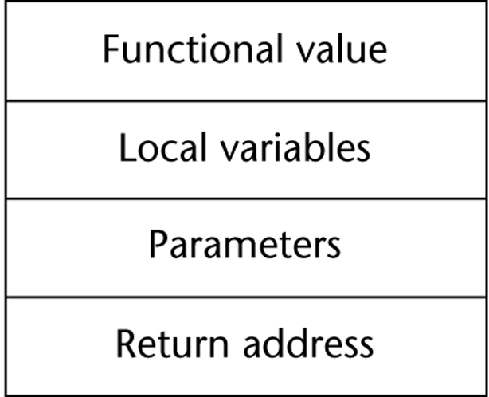
An Activation Record for “Simple” Subprograms
Because languages with simple
subprograms do not support
recursion, there can be only one
active version of a given subprogram
at a time
Therefore, there can be only a single instance of the activation record for a subprogram
Since activation record instance of a simple subprogram has fixed size it can be statically allocated. It could be also attached to the code part
Copyright © 2009 Addison-Wesley. All rights reserved.
1-<number>

Slide 9
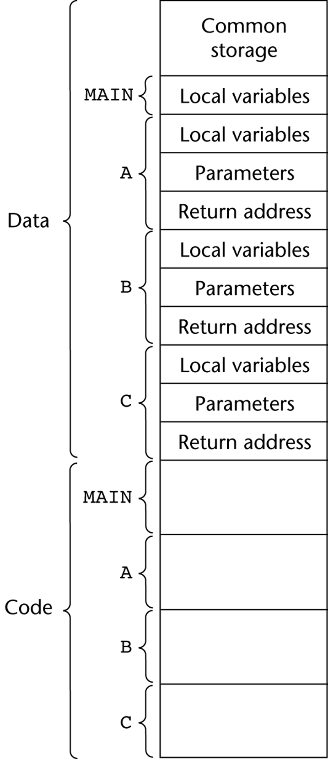
Code and Activation Records of a Program with “Simple” Subprograms
Note that code could be attached to ARIs
Also, the four program units could be compiled at different times
Linker put the compiled parts together when it is called for the main program
Copyright © 2009 Addison-Wesley. All rights reserved.
1-<number>

Slide 10
Implementing Subprograms with Stack-Dynamic Local Variables
Advantage of Stack-Dynamic Local Variables
  Support for recursion
More complex activation record
  The compiler must generate code to cause implicit allocation and deallocation of local variables
  Recursion must be supported (adds the possibility of multiple simultaneous activations of a subprogram)
  Each activation needs its own activation record and the number of activations is limited only by the memory size of the machine.
Copyright © 2009 Addison-Wesley. All rights reserved.
1-<number>

Slide 11
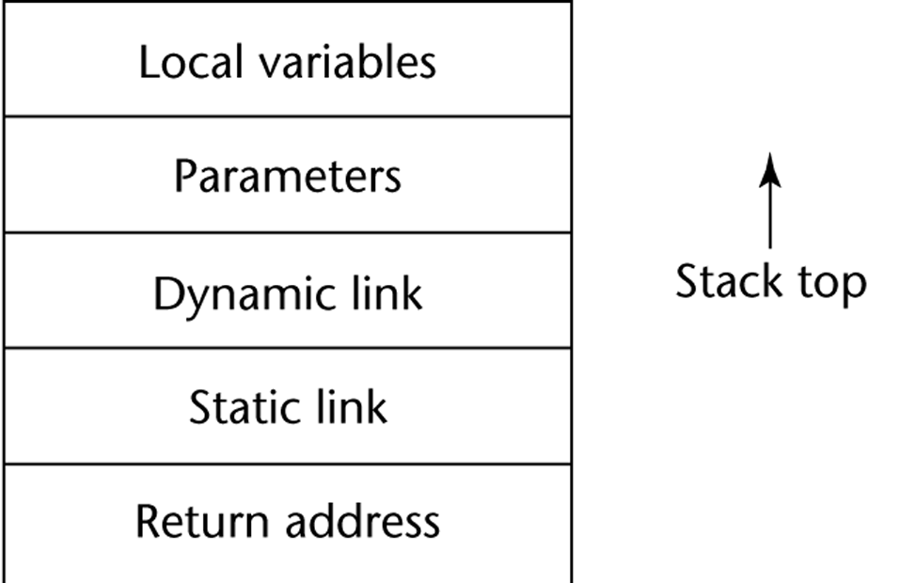
Typical Activation Record for a Language with Stack-Dynamic Local Variables
Return address: pointer to the code segment of the caller and an offset address in that code segment of the instruction following the call
Dynamic link: pointer to the top of the activation record instance of the caller
In static scoped languages this link is used to provide traceback information when a run-time error occurs.
In dynamic-scoped languages, the dynamic link is used to access non-local variables
Copyright © 2009 Addison-Wesley. All rights reserved.
1-<number>

Slide 12
Implementing Subprograms with Stack-Dynamic Local Variables
In most languages,
  The format of the activation record is known at compile time
  In many cases, the size is also known, because all the local data are of fixed size.
  In some languages, like Ada, the size of a local array can depend on the value of an actual parameter, so in those cases the format is static, but the size can be dynamic.
Copyright © 2009 Addison-Wesley. All rights reserved.
1-<number>

Slide 13
Implementing Subprograms with Stack-Dynamic Local Variables: Activation Record
An activation record instance is dynamically created when a subprogram is called
Because the call and return semantics specify that the subprogram last called is the first to complete, it is reasonable to use a stack, so
  Activation record instances reside on the run-time stack
Every subprogram activation (recursive or non-recursive) creates a new instance of an activation record on the stack.
The Environment Pointer (EP) must be maintained by the run-time system. It always points at the base of the activation record instance of the currently executing program unit
Copyright © 2009 Addison-Wesley. All rights reserved.
1-<number>

Slide 14
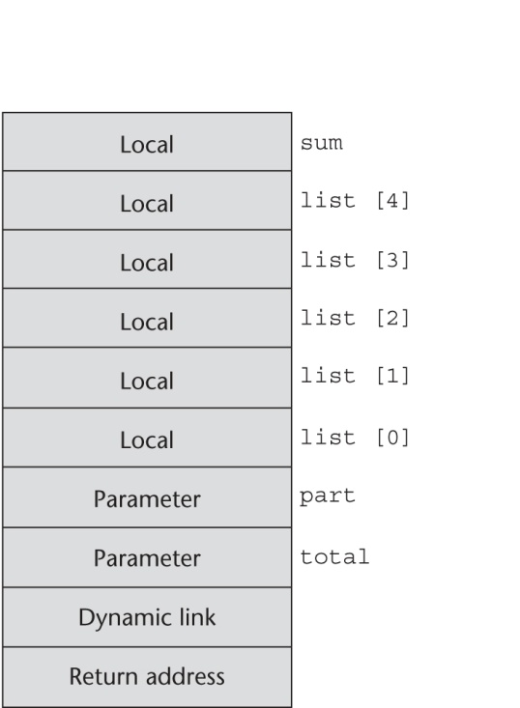
An Example: C Function
void sub(float total, int part)
{
int list[5];
float sum;
…
}
Copyright © 2009 Addison-Wesley. All rights reserved.
1-<number>

Slide 15
Revised Semantic Call/Return Actions
Create an activation record instance
Save the execution status of the current program unit
Compute and pass the parameters
Pass the return address of the callee
Transfer the control to the callee
1-<number>

Slide 16
Revised Semantic Call/Return Actions
Before (Prologue)
Save the old EP to the stack as the dynamic link and create the new value
Allocate local variables
After (Epilogue)
If pass-by-value-result or out mode parameters are used, move the current values of those parameters to their corresponding actual parameters
If it is a function, move the functional value to a place the caller can get it
Restore the stack pointer by setting it to the value of the current EP minus one and set the EP to the old dynamic link
Restore the execution status of the caller
Transfer control back to the caller
1-<number>

Slide 17
An Example Without Recursion
void fun1(float r) {
int s, t;
...
fun2(s);
...
}
void fun2(int x) {
int y;
...
fun3(y);
...
}
void fun3(int q) {
...
}
void main() {
float p;
...
fun1(p);
...
}
main calls fun1
fun1 calls fun2
fun2 calls fun3
Copyright © 2009 Addison-Wesley. All rights reserved.
1-<number>

Slide 18
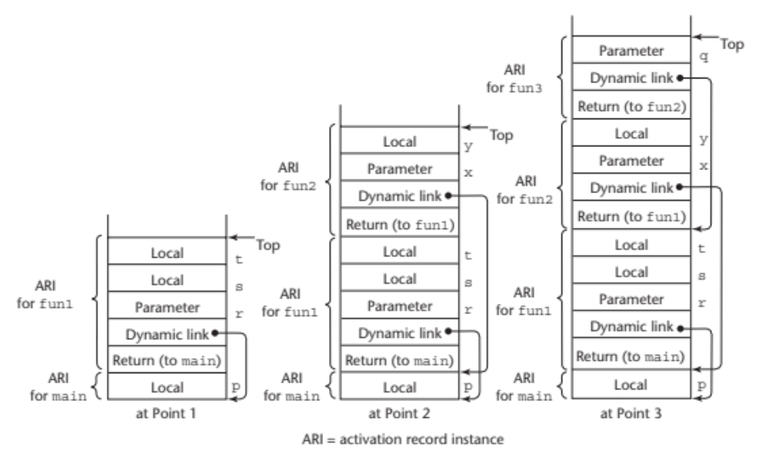
An Example Without Recursion
main calls fun1
fun1 calls fun2
fun2 calls fun3
Copyright © 2009 Addison-Wesley. All rights reserved.
1-<number>
1-<number>

Slide 19
Dynamic Chain and Local Offset
Dynamic chain (call chain): The collection of dynamic links in the stack at a given time
Local variables can be accessed by their offset from the beginning of the activation record, whose address is in the EP. This offset is called the local_offset
The local_offset of a local variable can be determined by the compiler at compile time
  How?
Copyright © 2009 Addison-Wesley. All rights reserved.
1-<number>

Slide 20
Recursion
int factorial (int n) {
<-----------------------------1
if (n <= 1)
return 1;
else return (n * factorial(n - 1));
<-----------------------------2
}
void main() {
int value;
value = factorial(3);
<-----------------------------3
}
Copyright © 2009 Addison-Wesley. All rights reserved.
1-<number>

Slide 21
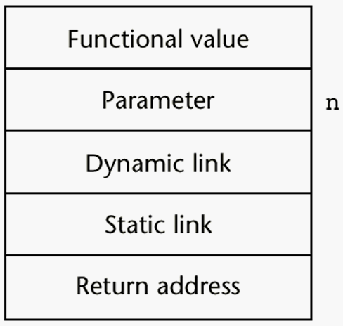
Activation Record for factorial
Copyright © 2009 Addison-Wesley. All rights reserved.
1-<number>

Slide 22
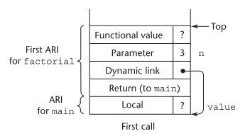
Stack contents during execution of main and factorial
1-<number>

Slide 23
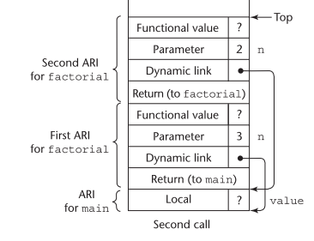
Stack contents during execution of main and factorial
1-<number>

Slide 24
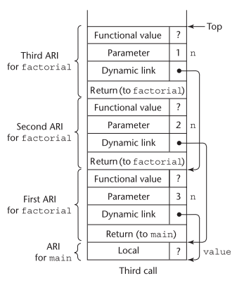
Stack contents during execution of main and factorial
1-<number>

Slide 25
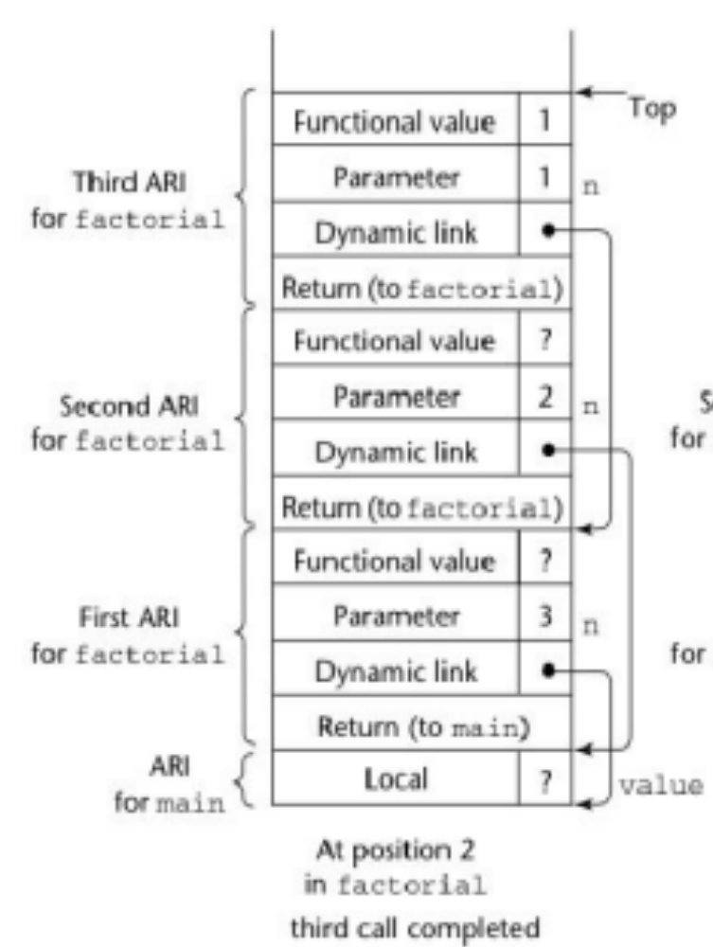
Stack contents during execution of main and factorial
1-<number>

Slide 26
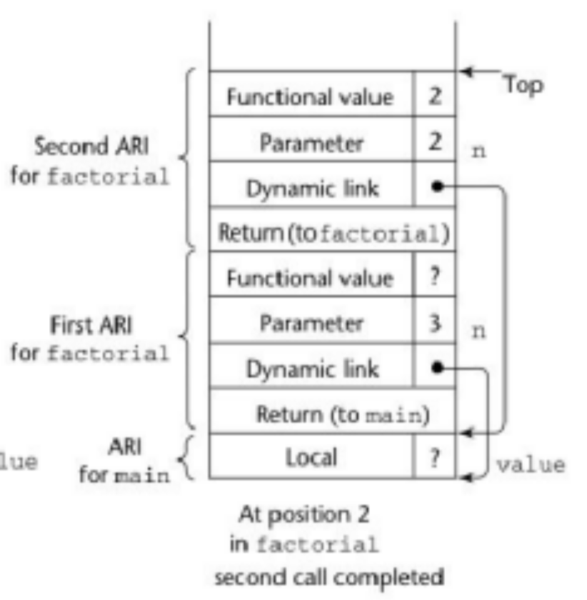
Stack contents during execution of main and factorial
1-<number>

Slide 27
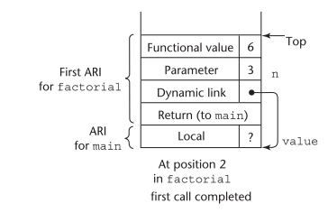
Stack contents during execution of main and factorial
1-<number>

Slide 28
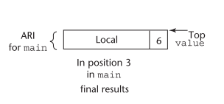
Stack contents during execution of main and factorial
1-<number>

Slide 29
Nested Subprograms
Some non-C-based static-scoped languages (e.g., Fortran 95, Ada, Python, JavaScript, Ruby, and Lua) use stack-dynamic local variables and allow subprograms to be nested
All variables that can be non-locally accessed reside in some activation record instance in the stack
The process of locating a non-local reference:
  Find the correct activation record instance
  Determine the correct offset within that activation record instance
Copyright © 2009 Addison-Wesley. All rights reserved.
1-<number>

Slide 30
Locating a Non-local Reference
Finding the offset is easy
Finding the correct activation record instance
  Static semantic rules guarantee that all non-local variables that can be referenced have been allocated in some activation record instance that is on the stack when the reference is made
Copyright © 2009 Addison-Wesley. All rights reserved.
1-<number>

Slide 31
Implementing Static Scoping
A static chain is a chain of static links that connects certain activation record instances
The static link in an activation record instance for subprogram A points to the bottom of one of the activation record instances of A's static parent
The static chain from an activation record instance connects it to all of its static ancestors
Static_depth is an integer associated with a static scope whose value is the depth of nesting => indicates how deeply it is nested in the outermost scope
Copyright © 2009 Addison-Wesley. All rights reserved.
1-<number>

Slide 32
Static Scoping (continued)
The chain_offset or nesting_depth of a nonlocal reference is the difference between the static_depth of the reference and static_depth of the procedure containing its declaration
A reference to a variable can be represented by the pair:
(chain_offset, local_offset),
where local_offset is the offset in the activation
record of the variable being referenced
Copyright © 2009 Addison-Wesley. All rights reserved.
1-<number>

Slide 33
Example Ada Program*
procedure Main_2 is
X : Integer;
procedure Bigsub is
A, B, C : Integer;
procedure Sub1 is
A, D : Integer;
begin -- of Sub1
A := B + C; <-----------------------1
end; -- of Sub1
procedure Sub2(X : Integer) is
B, E : Integer;
procedure Sub3 is
C, E : Integer;
begin -- of Sub3
Sub1;
E := B + A: <--------------------2
end; -- of Sub3
begin -- of Sub2
Sub3;
A := D + E; <-----------------------3
end; -- of Sub2 }
begin -- of Bigsub
Sub2(7);
end; -- of Bigsub
begin
Bigsub;
end; of Main_2 }
Copyright © 2009 Addison-Wesley. All rights reserved.
1-<number>

Slide 34
Example Ada Program (continued)
Call sequence for Main_2
Main_2 calls Bigsub
Bigsub calls Sub2
Sub2 calls Sub3
Sub3 calls Sub1
Copyright © 2009 Addison-Wesley. All rights reserved.
1-<number>

Slide 35
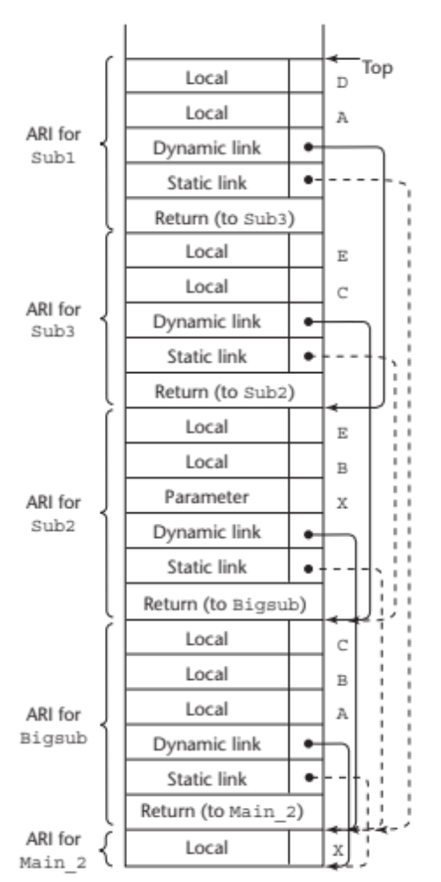
Stack Contents at Position 1
Copyright © 2009 Addison-Wesley. All rights reserved.
1-<number>

Slide 36
Evaluation of Static Chains
Problems:
1. A nonlocal reference is slow if the
nesting depth is large
2. Time-critical code is difficult:
a. Costs of nonlocal references are
difficult to determine
b. Code changes can change the
nesting depth, and therefore the cost
Copyright © 2009 Addison-Wesley. All rights reserved.
1-<number>

Slide 37
Blocks
Recall that blocks are user-specified local scopes for variables
An example in C
{int temp;
temp = list [upper];
list [upper] = list [lower];
list [lower] = temp
}
The lifetime of temp in the above example begins when control enters the block
An advantage of using a local variable like temp is that it cannot interfere with any other variable with the same name
Copyright © 2009 Addison-Wesley. All rights reserved.
1-<number>

Slide 38
Implementing Blocks
Two Methods:
  Treat blocks as parameter-less subprograms that are always called from the same location
    Every block has an activation record; an instance is created every time the block is executed
  2. Since the maximum storage required for a block can be statically determined, this amount of space can be allocated after the local variables in the activation record
Copyright © 2009 Addison-Wesley. All rights reserved.
1-<number>

Slide 39
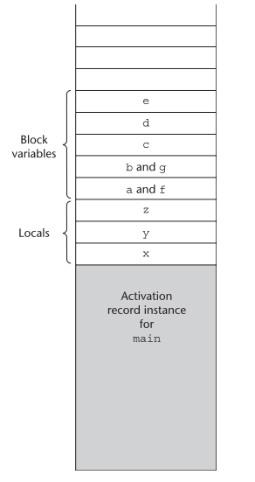
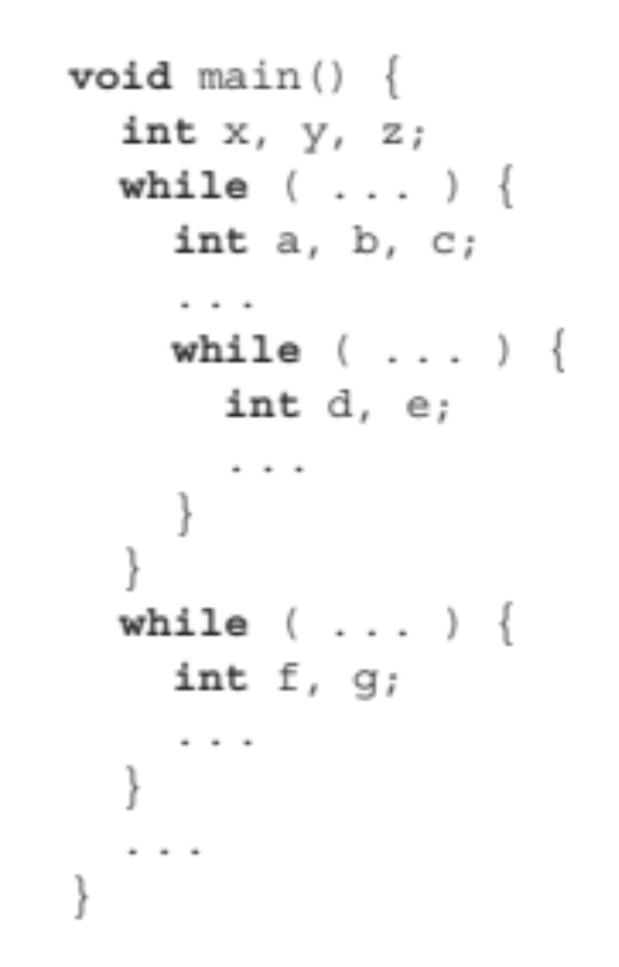
Implementing Blocks
Block variable storage when blocks
are not treated as parameterless
procedures
1-<number>

Slide 40
Implementing Dynamic Scoping
Deep Access: non-local references are found by searching the activation record instances on the dynamic chain
- Length of the chain cannot be statically
determined
- Every activation record instance must
have variable names
Shallow Access: put locals in a central place
  One stack for each variable name
  Central table with an entry for each variable name
Copyright © 2009 Addison-Wesley. All rights reserved.
1-<number>

Slide 41
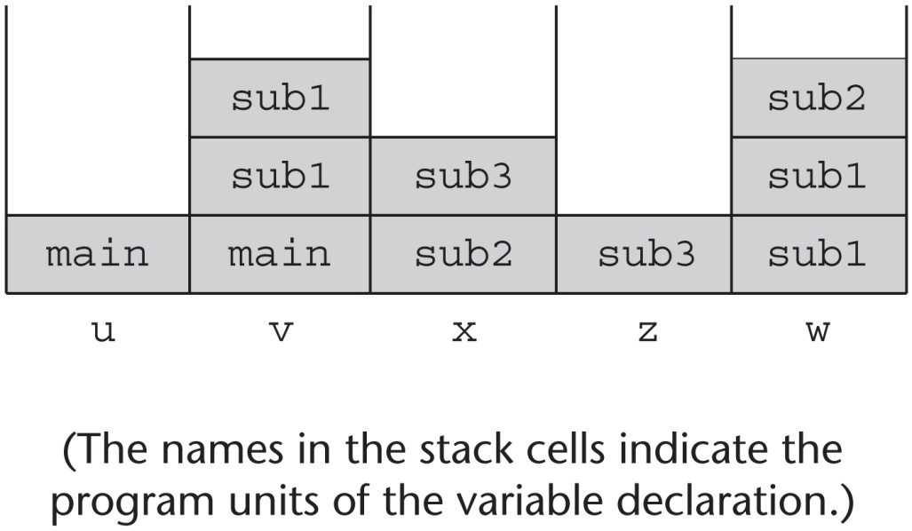
Using Shallow Access to Implement Dynamic Scoping
void sub3() {
int x, z;
x = u + v;
…
}
void sub2() {
int w, x;
…
}
void sub1() {
int v, w;
…
}
void main() {
int v, u;
…
}
main calls sub1
sub1 calls sub1
sub1 calls sub2
sub2 calls sub3
Copyright © 2009 Addison-Wesley. All rights reserved.
1-<number>

Slide 42
Summary
Subprogram linkage semantics requires many action by the implementation
Simple subprograms have relatively basic actions
Stack-dynamic languages are more complex
Subprograms with stack-dynamic local variables and nested subprograms have two components
  actual code
  activation record
Copyright © 2009 Addison-Wesley. All rights reserved.
1-<number>

Slide 43
Summary (continued)
Activation record instances contain formal parameters and local variables among other things
Static chains are the primary method of implementing accesses to non-local variables in static-scoped languages with nested subprograms
Access to non-local variables in dynamic-scoped languages can be implemented by use of the dynamic chain or thru some central variable table method
Copyright © 2009 Addison-Wesley. All rights reserved.
1-<number>

